Slide 1


Project Title Sales analytics & insights Presenter's Name Peter Gamal Date 11- May -2026

Slide 2
Project Idea
Overview:
This dataset was publicly released by Olist on Kaggle and contains real commercial data, covering 100,000 orders placed between September 2016 and October 2018 across multiple marketplaces in Brazil.
The problem:
Analyzing the sales data to figure out trends & customers behaviors to optimize the sales.
The solution:
We have made a dashboard for fast decision making and a python notebook for any further detailed analysis required.
Unique value:
The project combines complex data processing in the background with rich insights, delivered through simple, user-friendly, and intuitive dashboards.

Slide 3
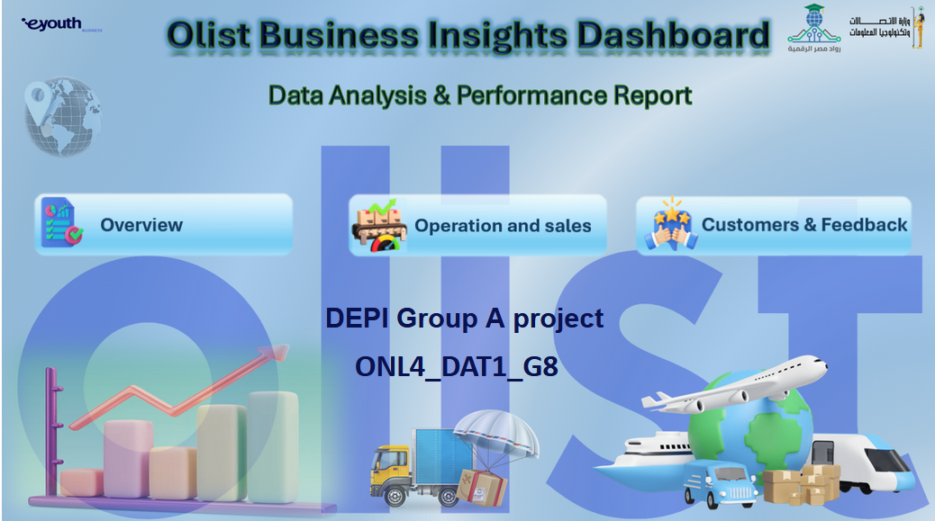
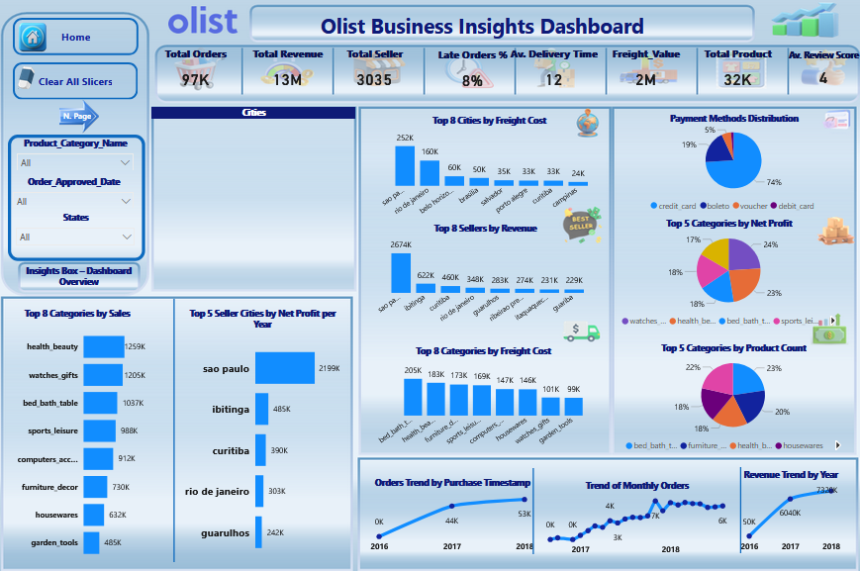
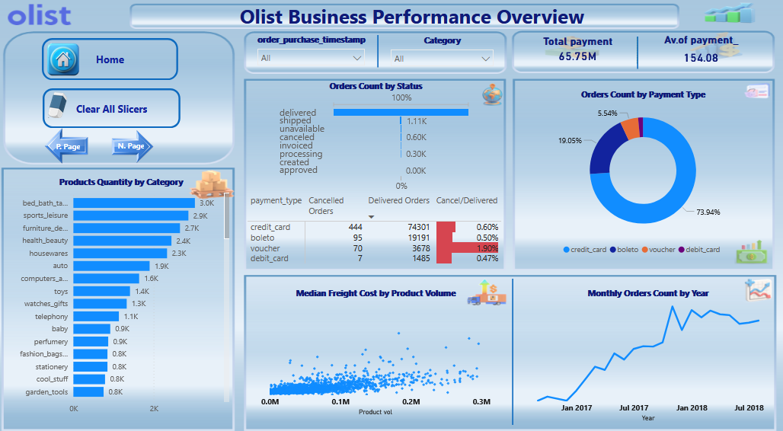
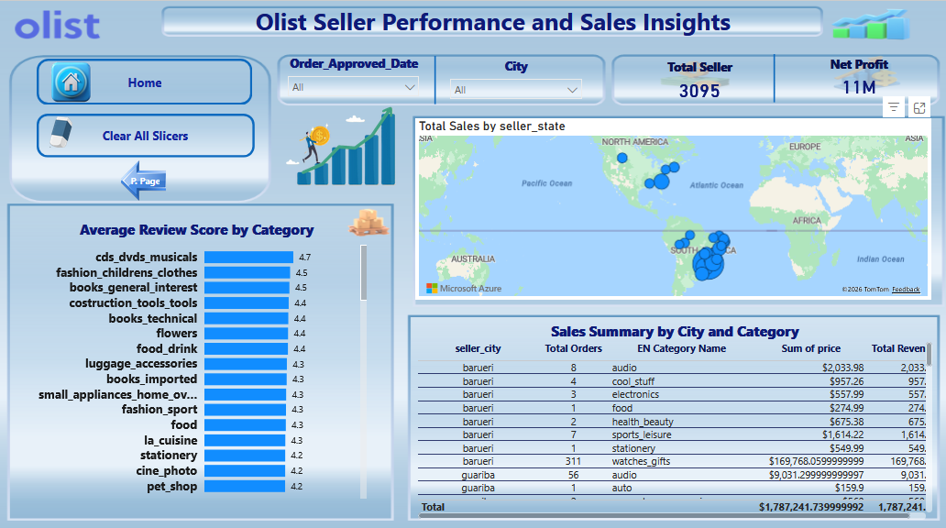
Project Wireframe

Slide 4
End users and features
Our Primary user for the dashboard is the stakeholders.
Key feature | Recommended Action | Expected Outcome
Increase revenue from dominant payment method | Increase partnerships with credit card providers | Higher average order value and increased repeat purchases
Protect Top Sellers | Conduct exit interviews for 4-5 star sellers. Review commission structures | Retention of the platform’s "Lifeblood" (Top 462 sellers).
Optimize Logistics | Partner with local warehouses in the Northeast region to reduce the late delivery rate. | Increased customer LTV (Lifetime Value) and higher average review scores.
Reduce voucher cancellation rate | Limit voucher usage to low-risk users/orders | Lower cancellation rate, and improved order completion rate

Slide 5
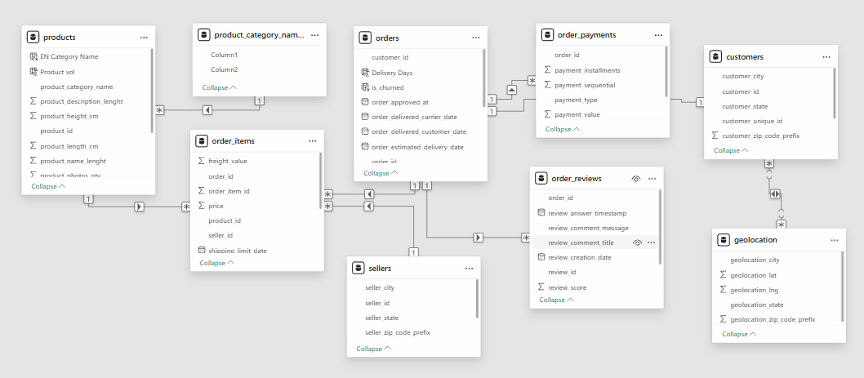
Data structure

Slide 6
Programming languages & Frameworks
Programming Languages
Python
SQL
Frameworks / Libraries
pandas
seaborn
matplotlib
plotly
sklearn
Tools
Microsoft Power BI
Microsoft Excel
Supporting Technologies
datetime (Python standard library module for date and time handling)

Slide 7
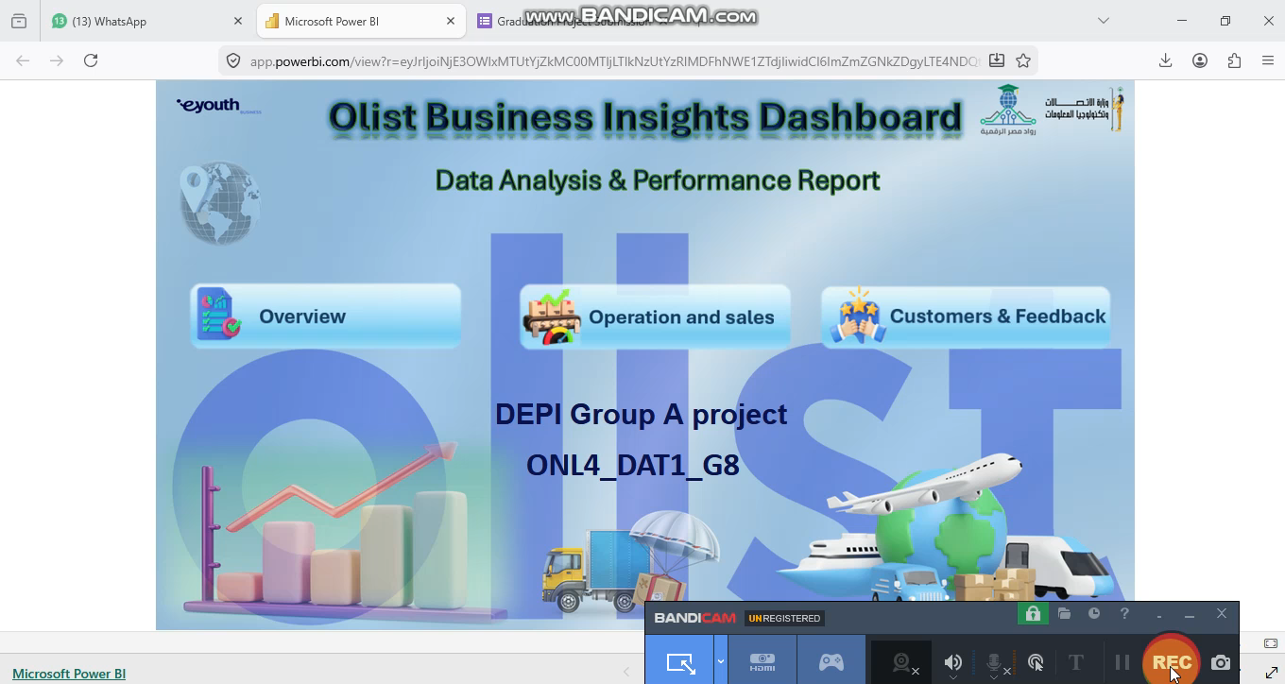
Live application & Test
Olist dashboard

Slide 8
Deliverables
Team data (Excel)
Project description file
Presentation file (PPT)
ZIP file containing raw data files (Source of data)
Power Bi Dashboard file (Live application link)
Project documentation file
https://github.com/peterabosaif/Data-analysis-

Slide 9
Project Team & Roles
Team Structure & Role
Key responsibilities
Team leader: Peter Gamal
Team member: Safa Hassan
Team member: Mohammed Hussein
Operations and sales
Overview
Customers and feedback
Collaboration methods: we mainly used whatsapp for chatting, zoom meeting and github to upload and merge python and SQL codes

Slide 10

Thank you
Contact information
Name | Email | Mobile
Peter Gamal Ragheb | peterabosaif@gmail.com | 01006275755
Safa Hassan Sadek | safahassan1888@gmail.com | 01096396125
Mohammed Hussein Hassan | mr.mh.mathematics@gmail.com | 01554199325

